Slide 1
62nd Annual Meeting:
The POWER of Economic Development
- 2015 in Review -
Mike Kirchhoff
President & CEO

Slide 2
CRDC Mission
The Clinton Regional Development Corporation unites and leads the region’s business and civic leadership to dynamically enhance the business climate and support primary employment decisions that improve the region’s economic health, prosperity, and quality of life.

Slide 3
Vision 2020 Strategies
Expand and Retain Existing Industries
Business Recruitment
Resolve Issues That Impede Growth
Communicate with All Stakeholders
Enhance Organizational Readiness

Slide 4
Expand and Retain Existing Industries
2 Corporate HQ visits
3 Technical Assistance Projects - Rail.One, Data Dimensions, & Nevada Rail Materials (NRM)
Chamber Golf Outing/Corporate Cup - New industry networking event won by WestRock.
Wage Survey - Saved local companies $11,000 by conducting a survey of hourly manufacturing wage rates.
New Existing Industry Manager - Hired in December; starts work on January 4
Notes:
Introduce Andy

Slide 5
Business Recruitment Project Activity
38 Total Projects Worked during 2015

Slide 6
Business Recruitment
Project Announcement (Envirovision) - On October 7, Project Tornado announced it had selected Clinton over Muscatine and Des Moines for its new post-industrial plastics recycling facility. Competitive wage rates was a key factor in selecting Clinton.
European Business Networking Events - Participated in two Chicago events attended by foreign firms and consular officials from six countries in Chicago
GACC Economic Outlook - Represented the Clinton Region at this event with German Ambassador Wittig in January
Site Selectors Guild Annual Meeting - Marketed the Clinton Region at this event, attended by 35 of the world’s leading site selectors in February
Chicago Site Selector Meetings - Joined Governor Branstad for meetings with Chicago-based site selectors in May
Notes:
Thanks to David Rose, Dennis Lauver, and Howes & Jefferies for their hard work on this project. Introduce Chris Cobb, Plant Manager. After starting with 6 employees, the company is now up to 10 and expect to be at 20 by spring 2016.

Slide 7
Business Recruitment
German American Business Forum - Represented the Clinton Region at the German-American Business Forum at the Munich IHK on June 24
Chicago International Trade Commissioners - Partnered with Quad Cities First to host a group of Chicago-based trade commissioners on July 9
Agritechnica Trade Show - Partnered with IEDA to Market the Clinton Region at this event in Hannover, Germany, November 5-12, including 14 meetings with companies from five countries
Target Industry/Competitive Base Analysis (Prager Company) - Thanks to the CCDA for their grant support of this project!

Slide 8
Resolve Issues That Impede Growth
Railpark Broker Selected - Following an extensive RFP and interview process, NAI Ruhl selected to market the railpark
Railpark Site Certification - Lincolnway Rail & Air Park advanced to Step 3
Railpark Engineering Studies - Olsson Associates selected to complete five required engineering studies for site certification
Iowa Transportation Day - CRDC representatives advocated for expansion of Highway 30 on January 28 in Des Moines
IDOT Highway 30 Public Input Meeting - Advocated for environmental impact study funding on April 14 in Davenport

Slide 9
Communicate with All Stakeholders
New CRDC Website - Launched for public access on January 5.
Speaking Engagements - 14 Presentations to community groups about the CRDC and economic development
Quarterly Investor Update - Regular Investor Update event began with the third quarter
Monthly Article - Began distributing a monthly article about economic development to all CRDC contacts; the article is also published in the Clinton Herald
Monthly Projects Update - Began producing a monthly project update email, which is distributed to all investors and stakeholders

Slide 10
Enhance Organizational Readiness
New Logo/Tagline for the CRDC
New CRDC Bylaws/Board Structure
New CRDC Employee Handbook
Vision 2020 Funding Campaign – From the public launch to the Celebration, the program exceeded goal by 6%
New Business Development Manager - Kreiling graduated from EDI and promoted into this new position, effective January 4
Renegotiated Lease on the Armstrong Building - Updated terms and rates for space we share with the Chamber of Commerce
Notes:
Recognize Jim Hizer and Mark Bergethon of Convergent
Congratulate Jenelle on graduating from EDI
Announce Jenelle’s promotion to Business Development Manager
Thank Rich for his work on the lease

Slide 11
Major 2016 Initiatives
Launch of New Existing Industry Program
CRDC Accreditation from the International Economic Development Council
Railpark Site Certification Complete
Competitive Base Analysis/Target Industry Report Complete
Target Industry Business Case Studies
Site Selectors Guild Marketing with the IEDA
German American Business Forum-Frankfurt with the IEDA
Notes:
New existing industry program: More industry networking events; increased number of company visits; plant manager/CEO roundtables; new managers receptions; workshops; industry linkages; and more
Great to partner with IEDA on major events

Slide 13
62nd Annual Meeting:
The POWER of Economic Development
- Reflecting on 2015 -
Rich Phelan
Board Chair

Slide 15
62nd Annual Meeting:
The POWER of Economic Development
- Vision 2020 Funding Initiative -
Bruce Christensen
Co- Chair, Vision 2020

Slide 16
Investor Statistics
Pre-Vision 2020 Today
Investors 75 152
Annual Investment $325,715 $584,475
5-Year Total $1,628,575 $2,922,375

Slide 18
62nd Annual Meeting:
The POWER of Economic Development
- Preview of 2016 -
Ron Gutierrez
Chair-Elect

Slide 19
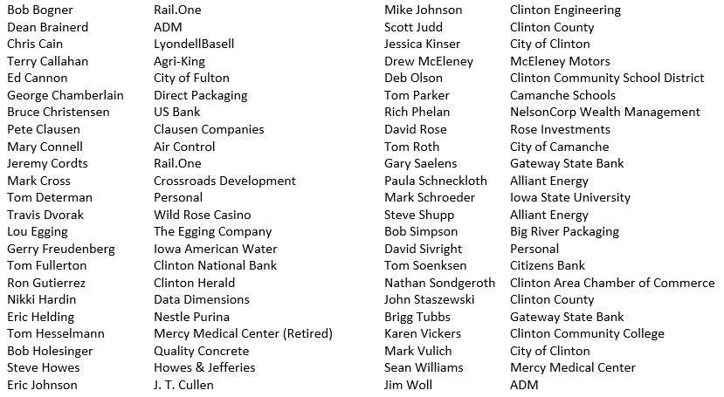
2016 Board of Directors

Slide 20
Retiring Board Members
Jeff Beckwith Tom Mosher
John Eisenman Steve Thacker
Charles Minnick Jon Thoms
Casey Moore Ryan Veenstra

